Slide 1

Conjoint Survey Experiments
MY560 Methodology Workshop
Noam Titelman (AxPo, Sciences Po; LSE, Methodology)
noam.titelman@sciencespo.fr

Slide 2


Which one do you prefer

Slide 3
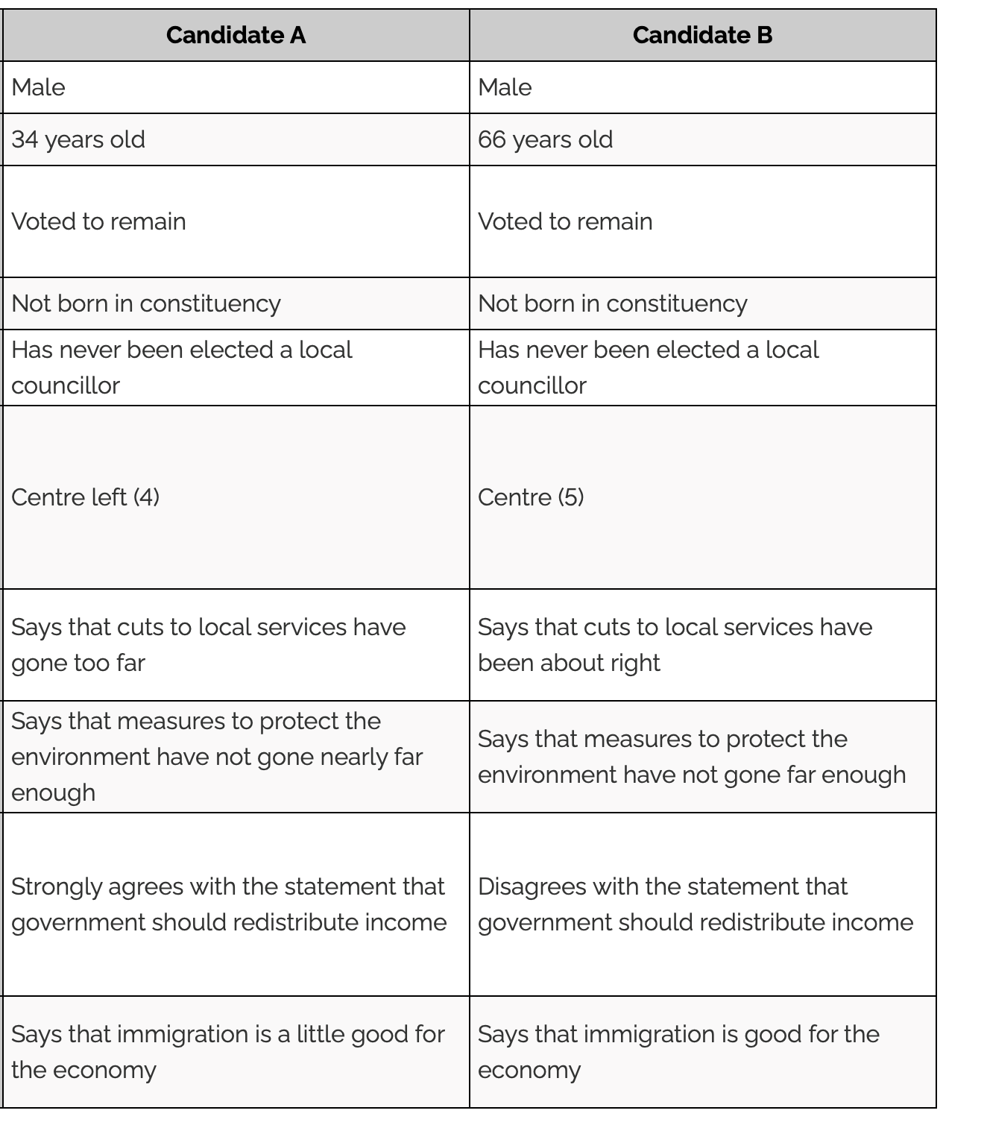
Which one do you prefer

Slide 4
Dichotomic decisions with multifactorial elements
Tourism packages
Schools
Policy preferences
Immigration attitudes
Partners
Jobs
Candidates
Etc.

Slide 5
Conjoint experiments
Specifically, these method is operationalized with the following four steps (Louviere et al. 2007).
First, attributes are identified in “ad hoc and research specific ways” (p.60).
Second, levels of the attribute are defined (again in an ad hoc fashion) and the attribute level combinations are defined in some experimental form.
The simplest of theses designs is an orthogonal fractional array (every level appears randomly and the probabilities of the different levels of one attribute are independent from other attributes).
Third, once this experimental design is determined, the elicitation task is designed, usually some form of preference elicitation.
Finally, the responses are collected from a sample, and the data analysed.

Slide 6
Conjoint experiments
The potential benefits of this method are reflected in the fact that since their original introduction in the 1970s (Green and Rao, 1971; Krantz and Tversky, 1971) they have become widely used in different fields as marketing (e.g. Green, Krieger, and Wind, 2001; Raghavarao, Wiley, and Chitturi, 2010), economics (e.g Adamowicz et al., 1998), and health services (Bridges et al. 2008; Ryan and Gerard, 2003).
Finally, in recent years this method has had an especially important prevalence in political science (e.g. Hainmueller et al., 2014; Carnes and Lupu, 2015; Bansak et al., 2016).
Despite the growing importance of this technique: “researchers have paid little attention to questions about how to optimally design conjoint surveys given well-known challenges in survey research” (Bansak, et al. 2018

Slide 7
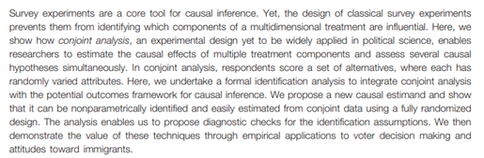
Conjoint experiments in Political Science
Hainmueller, J., Hopkins, D. J., & Yamamoto, T. (2014). Causal inference in conjoint analysis: Understanding multidimensional choices via stated preference experiments. Political Analysis, 22(1), 1-30.

Slide 8
Conjoint experiments in political science
ubiquitous
Survey experiments had become ubiquitous.
For example, three leading political science journals, the American Journal of Political Science, the American Political Science Review, and the Journal of Politics published seventy-two papers employing survey experiments, between 2006 and 2010 (Hainmueller et al. 2014).
As survey experiments have become more frequent so have become the questions on the external validity of their findings. External validity refers to the “extent to which causal relationship holds over variations in persons, settings, treatments, and outcomes” (Shadish, 2002, p.83).
“conjoint survey experiments” have been claimed to mimic more truthfully real decision tasks (e.g. Louviere et al 2000; Hainmueller et al. 2015).

Slide 9
Conjoint experiments in political science
ubiquitous
The advantages of conjoin experiments according to Hainmueller et al. (2014):
By including several attributes, this method enhances realistic situations, when compared with other experiments which creates more unrealistic scenarios with less attributes
This mechanism presents important cost-efficiency by testing several causal hypothesis simultaneously
Since the impact of the different attributes is measured simultaneously on the same outcome, it is possible to compare the relative size of effects
Conjoint analysis reduces concerns about social desirability bias, by allowing the respondents to justify their answers with any of the multiple attributes present

Slide 10
Assumptions
All of the assumptions can be partially guaranteed or tested
No Carry Over Assumption. First, we assume stability and no carryover effects for the potential outcomes. For example, in the candidate conjoint experiment above, respondents would choose the same candidate as long as the two candidates in the same choice task had identical attributes, regardless of what kinds of candidates they had seen or would see in the rest of the experiment
No Profile-Order Effects. It possible for researchers to ignore the order in which the profiles’ attributes happen to be presented
Randomization of the Profiles. Potential outcomes are statistically independent of the profiles (the experimental setting guaranteed through randomisation)

Slide 11
Causal Quantities of Interest and Identification
Average Treatment Effect (ATE). Whole profile effect (rarely of interest, but sometimes it is). Also, number of potential profiles can be too large.
Average Marginal Component Effect (AMCE). This quantity equals the increase in the probability that a profile would be chosen if the value of its lth component were changed from t0 to t1, averaged over all the possible values of the other components given the joint distribution of the profile attributes p(t)
In some applied settings, it is not necessarily clear what distribution of the treatment components analysts should use to anchor inferences. In the worst-case scenario, researchers may intentionally or unintentionally misrepresent their empirical findings
In practice, we suggest that the uniform distribution over all possible attribute combinations be used as a default, unless there is a strong substantive reason to prefer other distributions. (orthogonal fractional array )
Conditional Average Marginal Component Effect (AMCE).

Slide 12
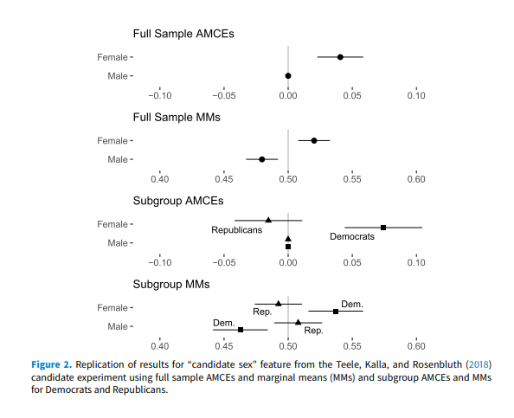
Careful with AMCE in subgroups (Leeper et al., 2020

Slide 13
A few notes on AMCE
AMCE of an attribute value is always defined with respect to reference level
Defined with respect to the joint distribution of profiles (of their levels and attributes)
AMCE hide heterogeneity (it is an average) and combines size and frequency (in electoral context, a positive AMCE does not imply that most respondents prefer the attribute (Abramson et al. 2019))
Real-world empirical validation that it recovers the value of interest in Swiss citizenship elections (Hainmueller et al. 2015)

Slide 14
Sample: online panels (mostly)
Few face-to-face (for an exception see Lupu, 2013)
Representative, benchmarked, online
Companies that design the instrument (YouGov, Delta Poll, etc.)
Companies offer a pool of respondents, and one has to design the experiment (Qualtrics)

Slide 15
Analysis of conjoint data
Difference of means or linear regression
In complete independent randomization of attributes estimates should be the same
Linear regression allows to increase efficiency. This can be done “dumming” the variables. Thanks to the randomization we do not need to worry about functional form
When using a different distribution of randomization; including dependencies between attributes, we need to make model assumptions.

Slide 16
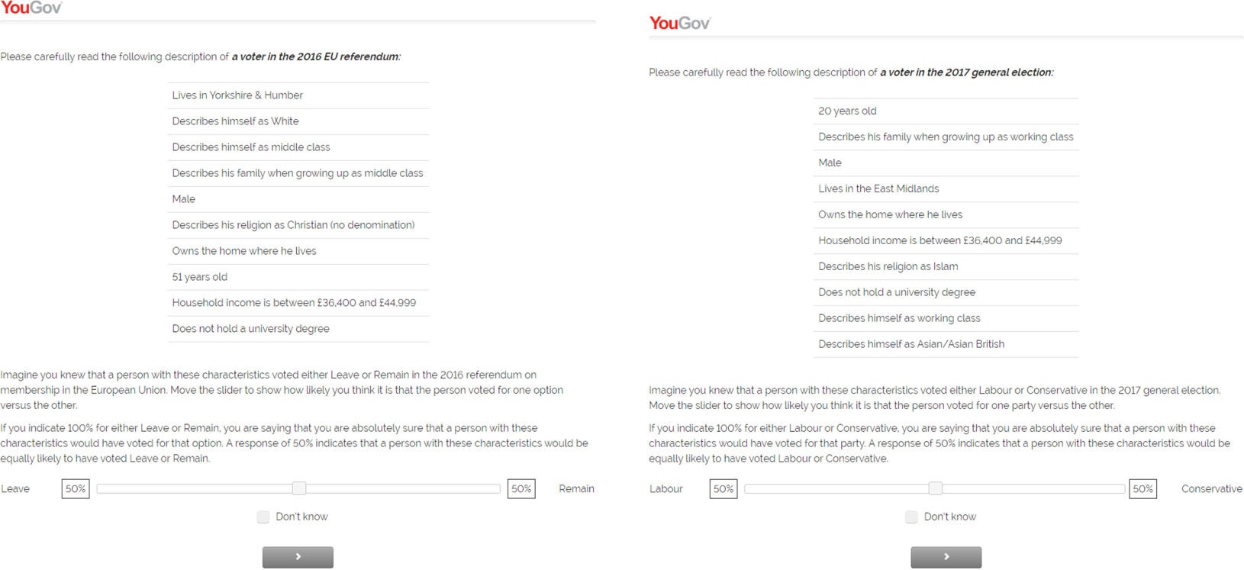
Example of employing a different distribution: AMCE with benchmark (Titelman and Lauderdale, 2023)

Slide 17
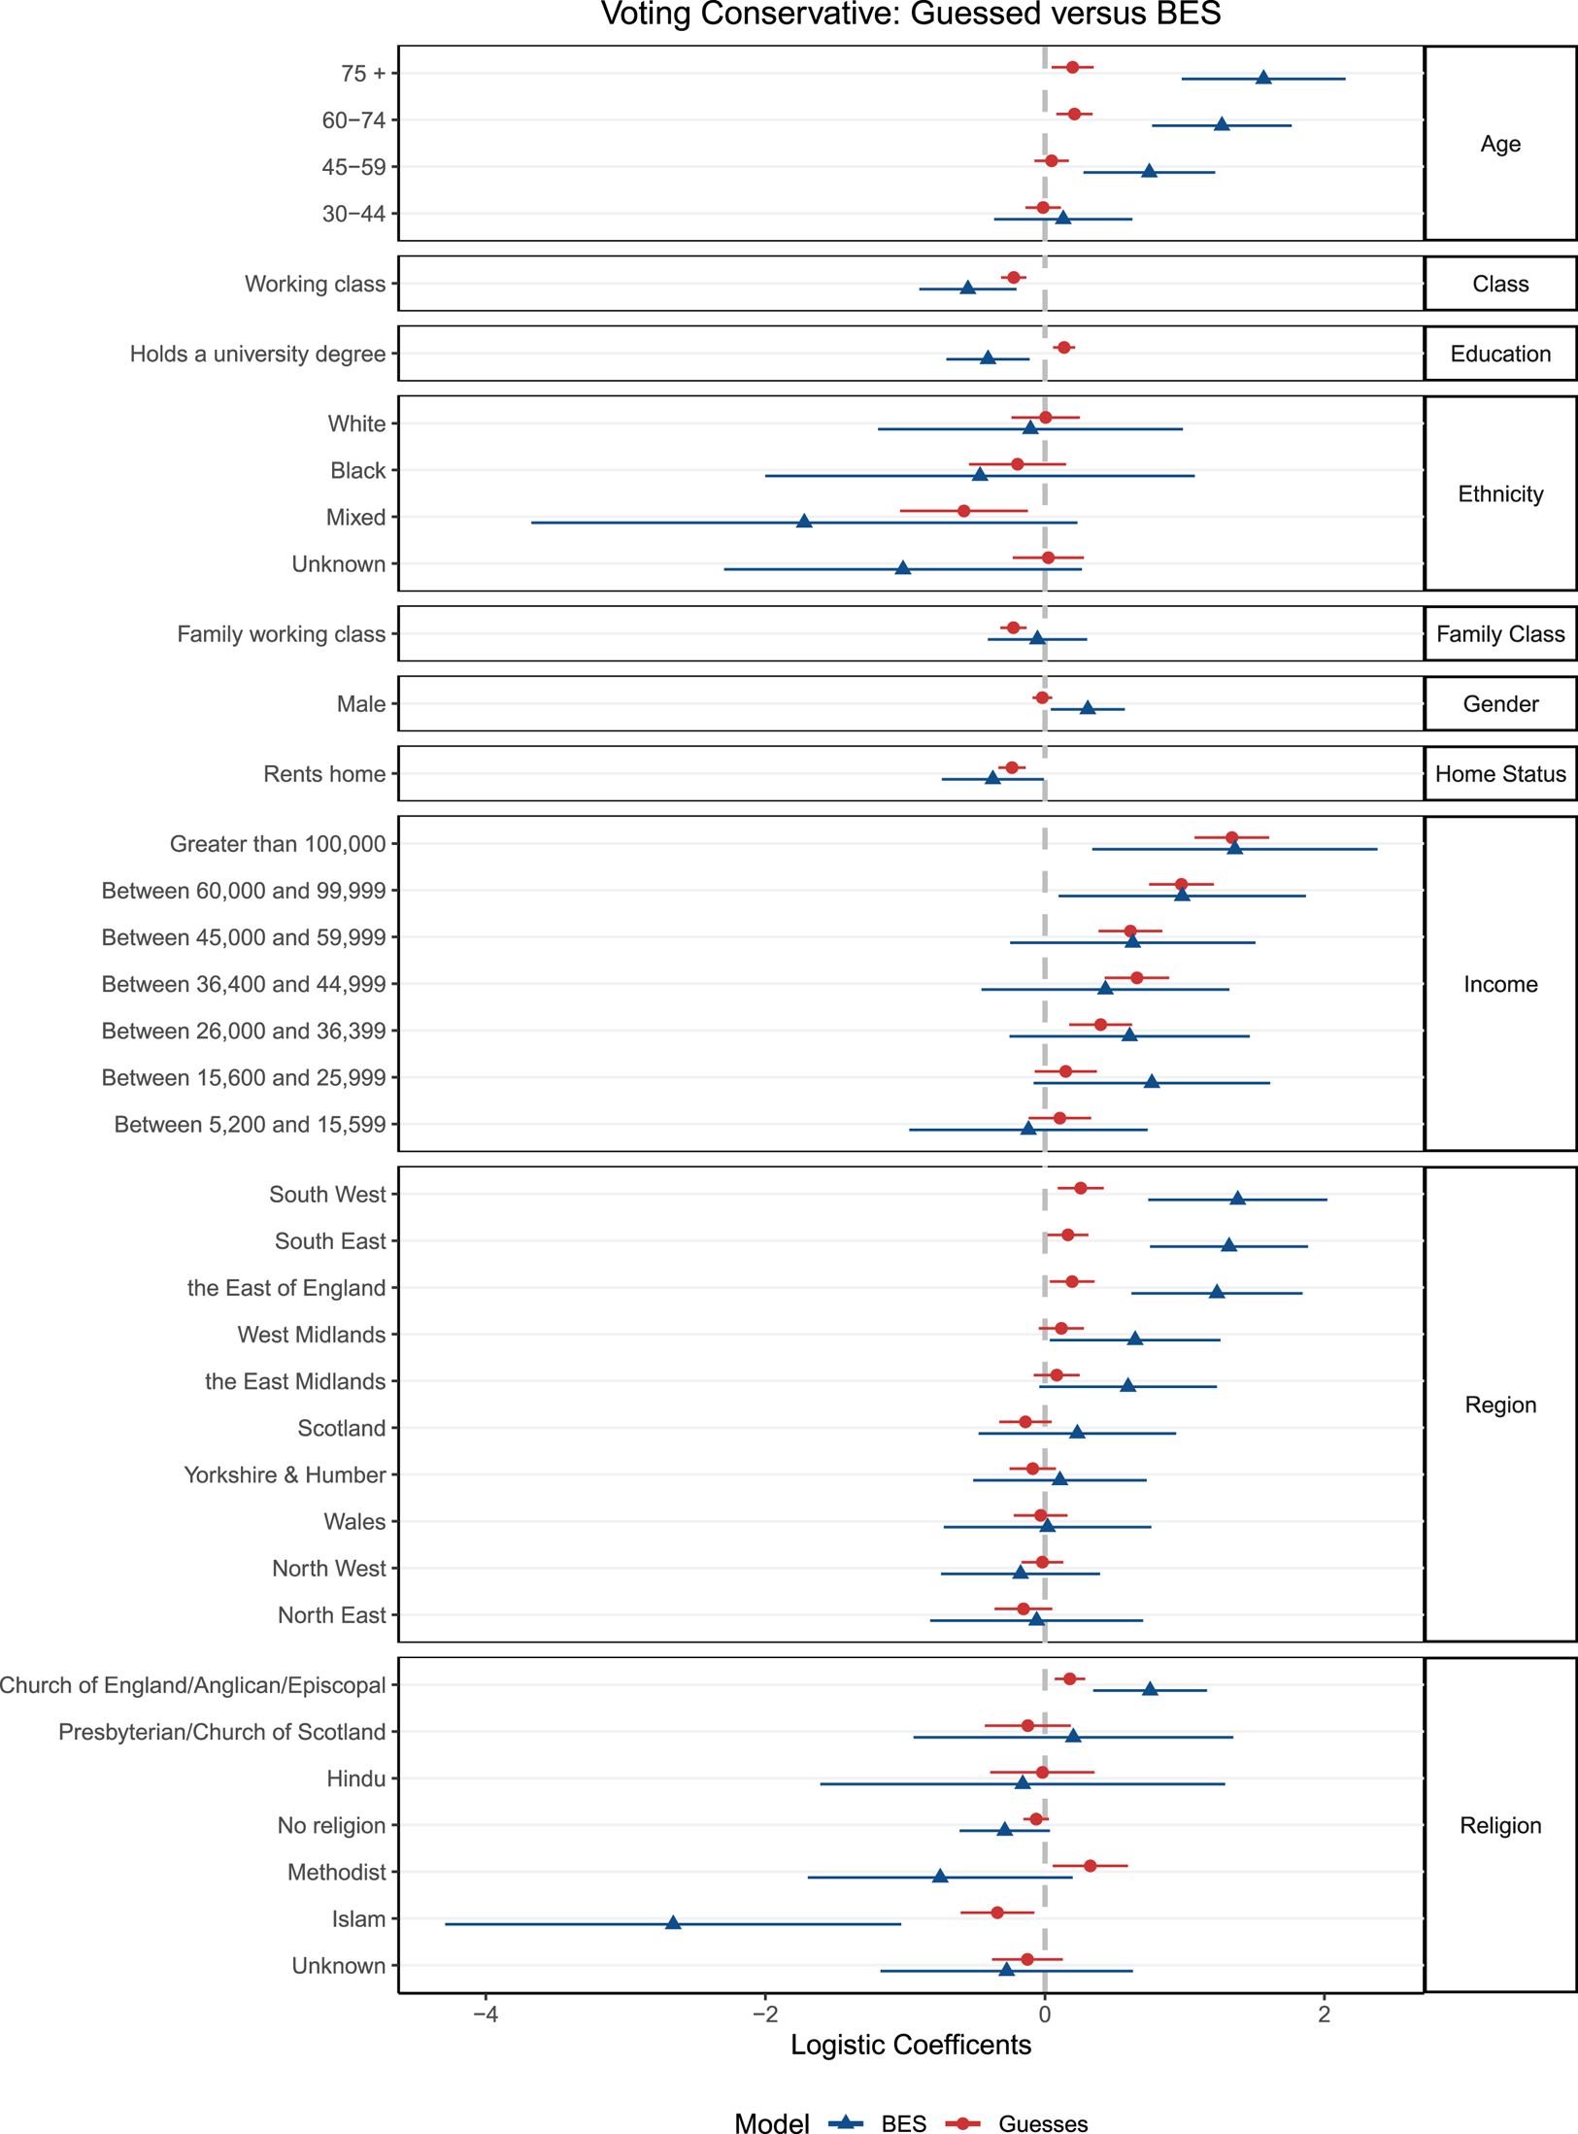
Example of employing a different distribution: AMCE with benchmark

Slide 18
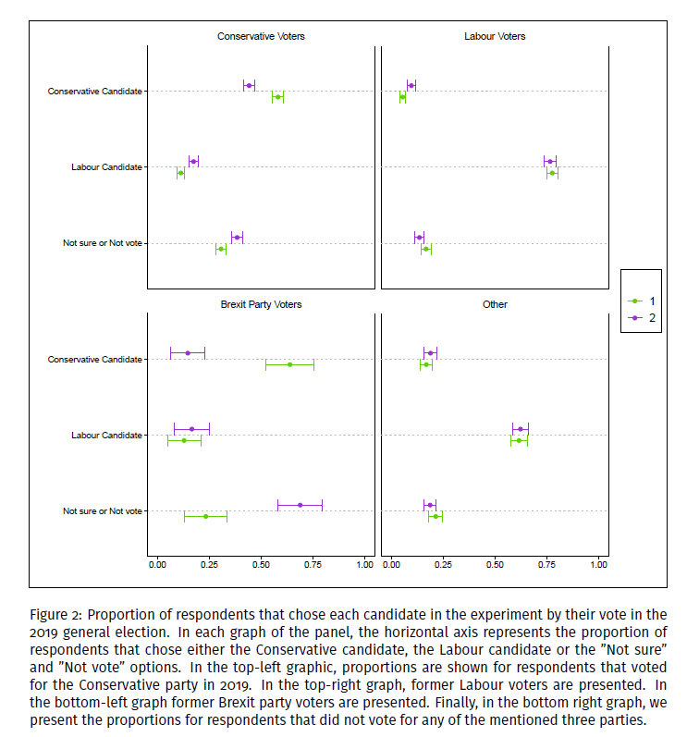
Example of employing a different distribution: ATE with benchmark (Titelman and Lauderdale, forthcoming)

Slide 19
Risks of satisficing to conjoint experiments
In particular, because of their multi-dimensional nature, conjoint surveys imply relatively large number of pieces of information given to the respondents which increases the risk that the respondents’ use “short-cuts” or effort-saving heuristics (Berinsky et al. 2014).
Simon’s (1957) concept of satisficing lies behind this phenomenon. According to this notion when people are faced with a demanding task, in terms of the amount of information required they only exert the minimum effort required to take an acceptable (or satisfactory) answer.
Additionally, in the case of surveys, in general, and conjoint surveys, in particular, there is an important risk of such strategies because there is little reason to believe that the respondents are particularly motivated.
The high difficulty, in terms of information processing, that characterizes conjoint surveys, and the low motivation, that characterizes surveys in general, increase the probability of satisficing (Krosnick et al. 1996).

Slide 20
Risks of satisficing to conjoint experiments
Internal validity question: Many attributes do not affect needed sample size and power analysis (For AMCE estimator and uncorrelated attributes).
Orme (1998) rule of thumb N > 500c/(t × a)
The number of choice tasks (t), the number of alternatives (a), and the largest number of levels for any of the attributes (c)
(If you are interested, Martin Lukac, in our Department, has done some amazing work on power analysis for conjoins and knows a lot more than I do)
External validity question: Masking versus Satisficing Bansank et al. (2021)
Masking: If there are too few attributes, their quantities of interest could mask the effects of other omitted attributes.
Satisficing: If researchers include too many attributes, they may encourage survey respondents to develop time-saving shortcuts that reduce the thoughtfulness of their responses. (think of an absurdly extreme case)

Slide 21
Risks of satisficing to conjoint experiments
Beyond the “breaking point”
The “power temptation”. What is the power of the statistical test of a conjoint with n+1 attributes compared to n attributes? And n+1000?
How many levels is too many levels?
Bansank et al. (2021) find surprisingly little satisficing (even with 35 “filler” attributes respondents’ answers do not change)
Similar conclusions using eye-tracking (Jenke et al. 2021)

Slide 22
Risks of satisficing to conjoint experiments
“Talk is cheap”: There is an increasingly relevant question on the capacity of survey experiments to predict the way public opinion actually changes in the real world (e.g. Gaines et al., 2007; Kinder, 2007; Barabas and Jerit, 2010).
A wider problem for survey methods (and other like interviews)

Slide 23

Application
Create your own conjoint
noamtitelman/ConjointWorkShop: MY560 LSE Methods Workshop (github.com)

Slide 24
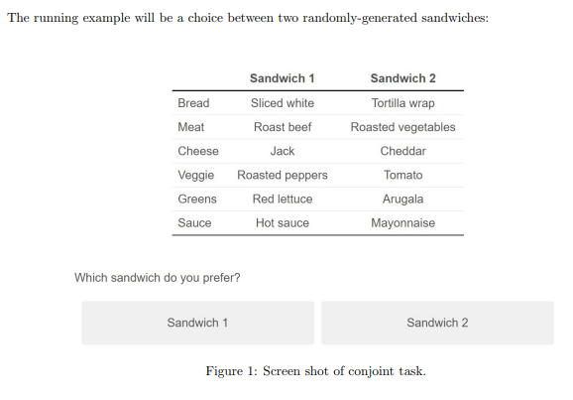
Programming Choice Experiments in Qualtrics
The following example was developed by Matthew H. Graham (2020)

Slide 25
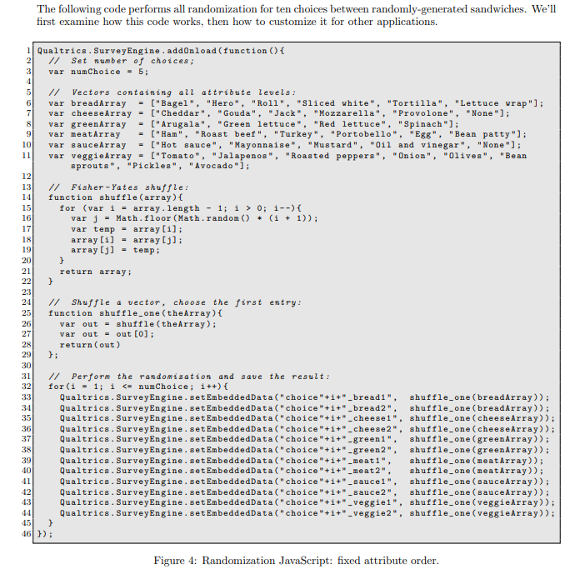
Qualtrics
Create new project
Access the JavaScript editor
Be careful when copy-pasting (sensitive to space)

Slide 26
Adapt the code to your application
To adapt the code to your own purpose, begin by setting the number of choice tasks (line 3) and the changing the attribute levels (lines 6-11).
There is no requirement that each attribute have the same number of levels, or limit on the number of levels. If you change the names of the arrays — you probably should — don’t forget to make corresponding changes in lines 33-44. The shuffle functions on lines 14-29 do not need to be edited, unless you want to change the randomization scheme.
The names of the embedded variables that you set in lines 33-44 will eventually appear in your data. For example, in line 33, the text "choice"+i+" bread1" means that the variables choice1 bread1, choice2 bread1, ..., choice5 bread1 will be created.
You can change this format to match your preferences. Just remember to carry it all the way through in subsequent steps.

Slide 27
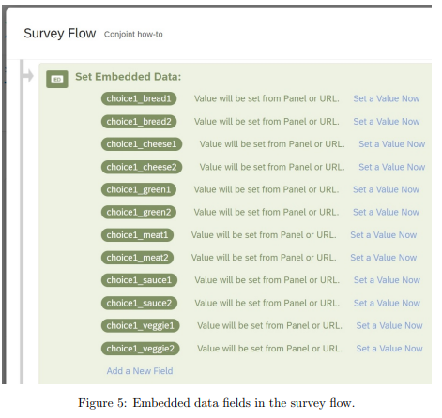
Store the results of your randomization
It must be above the question block that includes your randomization JavaScript

Slide 28
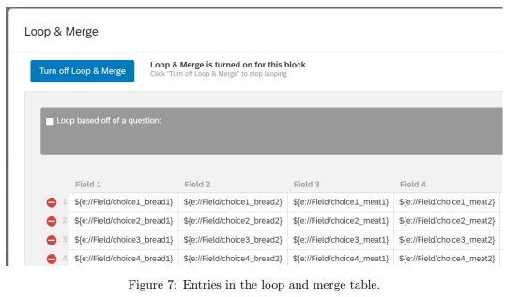
Create a loop and merge block
A pop-up containing the loop and merge table will appear (Figure 7). Fill in the names of your embedded variables using the following syntax: ${e://Field/variable}. In place of variable, you’ll use whatever syntax you used in lines 33-44 of the JavaScript
Might be worth doing it in Excel

Slide 29
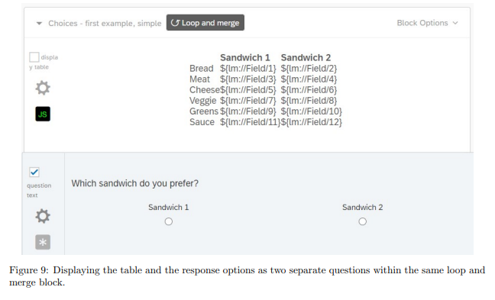
Create the question (HTML)
Table that displays the choices, and a question that records the choices. The formatting of the table behaves better when the table and the question are programmed as two separate questions on the same page
It’s better to edit your HTML in a separate program like NotePad, then paste it into the HTML view tab each time you want to make a change. This is because Qualtrics automatically adds a bunch of unnecessary tags that will clutter up your code

Slide 30
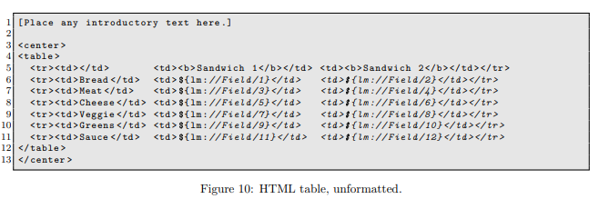
HTML table
To make the table look more professional, we’ll take advantage of cascading style sheets (CSS)

Slide 31
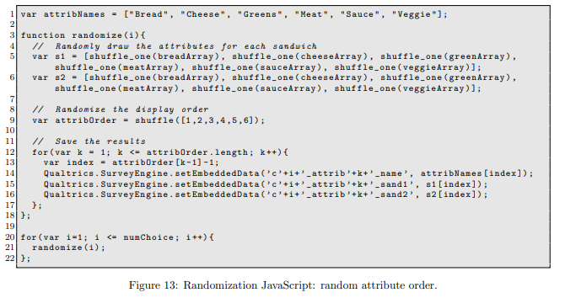
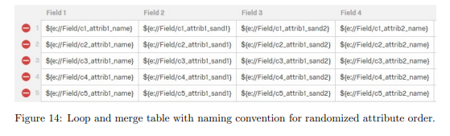
Costumize: randomization
Doing this requires two key steps: modifying lines 30-45 of the randomization JavaScript displayed in Figure 4, and adopting a new naming convention for the embedded variables
To account for the fact that the attributes (bread, meat, cheese, etc.) are going to appear in random order, we need to modify the naming convention for the attributes, which had previously hard-coded bread, cheese, etc.
You’ll also need to use this variable naming convention in your survey flow (Figure 5) and your loop and merge table (Figure 7).

Slide 32
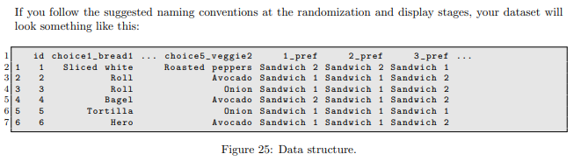
Format and Analysis
Answer the survey 10 or 15 times
When you download your data from Qualtrics, each row will represent a respondent.
. It requires the dplyr and magrittr packages, both of which are installed as part of the tidyverse package

Slide 33
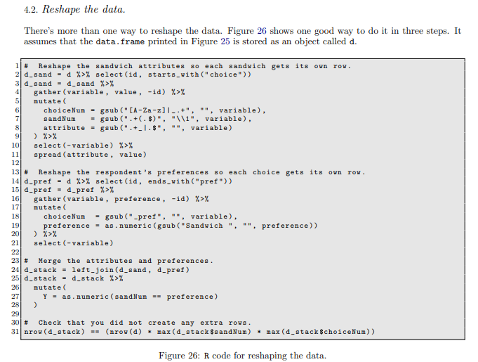
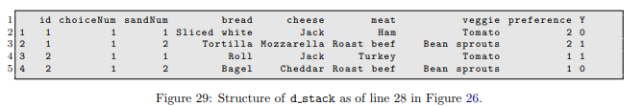
One possible coding

Slide 34
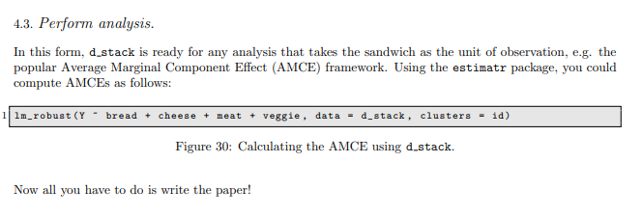
Analysis
Because of full independent randomization you can run the analysis
as linear regression or means difference

Slide 35
Thank you!

Slide 36
References
Lupu, N. (2013). Party brands and partisanship: Theory with evidence from a survey experiment in Argentina. American Journal of Political Science, 57(1), 49-64.

